Slide 1
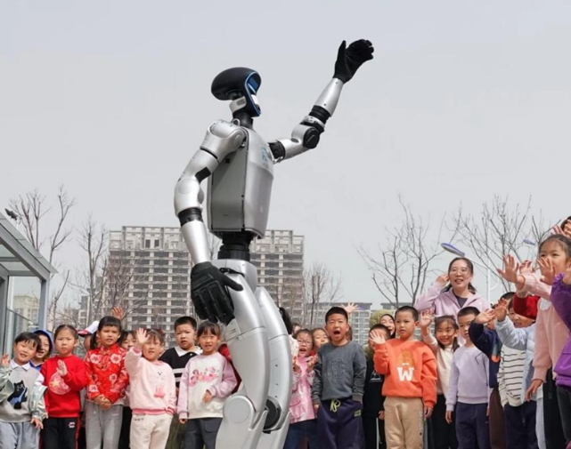
SIX1015 Science, Technology and Society Semester 2 2025/2026
Week 5 - Part 1: Ethical Implications of Science and Technology

Slide 2
Ethical implications of science, technology on society
Ethical implications
Ethical implications arise when science and technology:
Produce impacts on society and environment
Affect groups unequally
Involve risks and uncertainty
Raise questions of responsibility
Require justification of decisions
Influence trust and legitimacy
Science and Technology
Society
Is it ethical?
Should it be allowed?

Slide 3
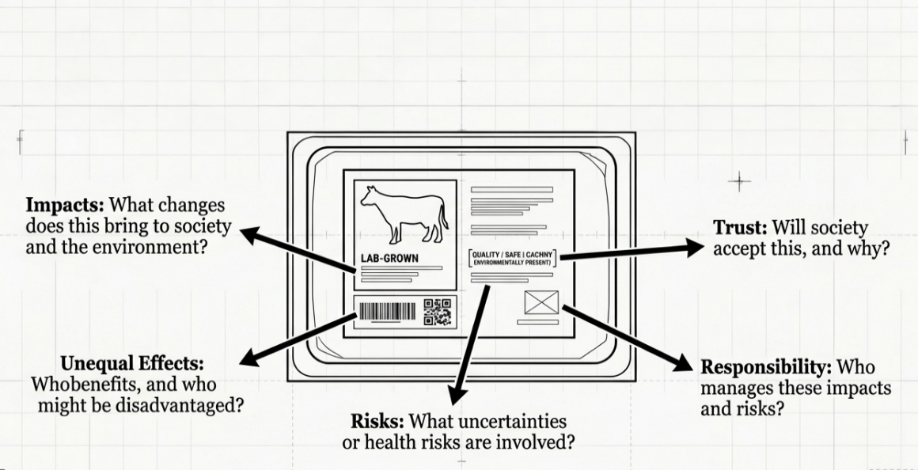
Case example: Cultured meat

Slide 4
Making ethical decision
How to evaluate whether cultured meat is acceptable?
What principles or frameworks that can guide decision-making?
What is the most appropriate decision?
What would be the responsible course of action?

Slide 5
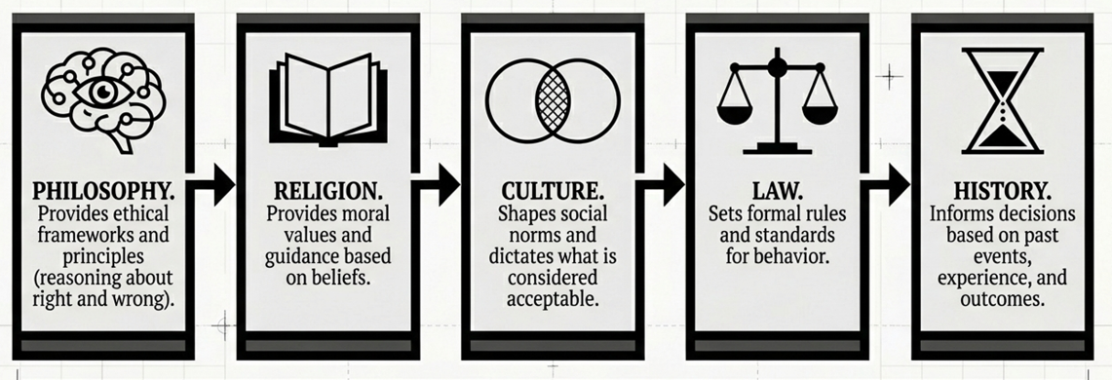
Sources of ethical judgements

Slide 6
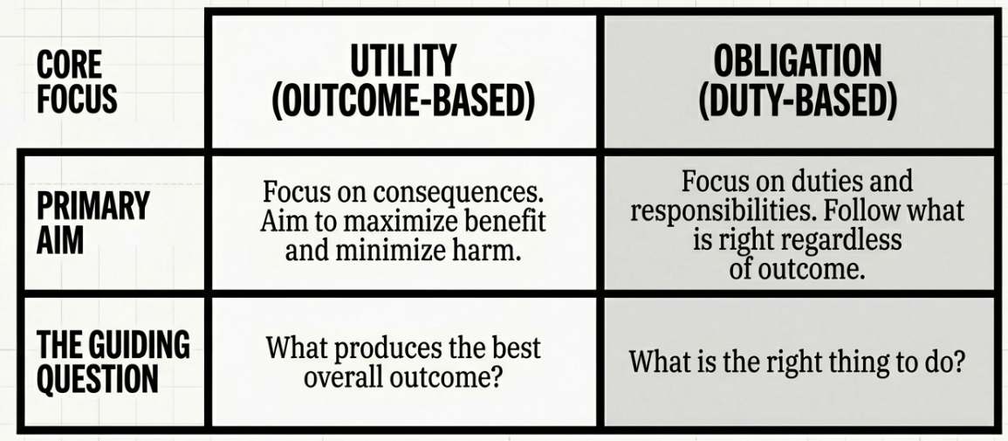
Main approach in ethics

Slide 7
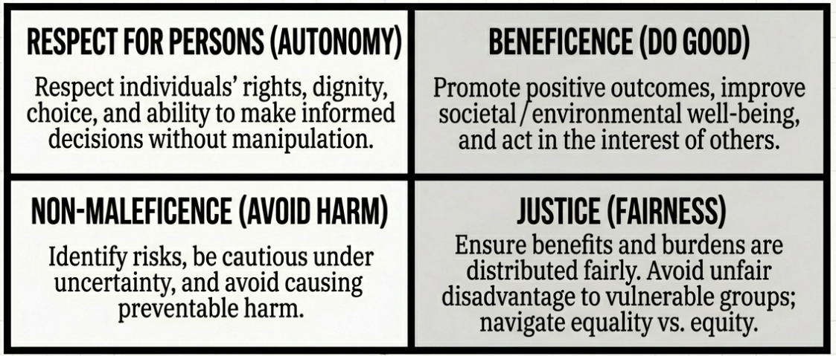
Four principles in bioethics

Slide 8
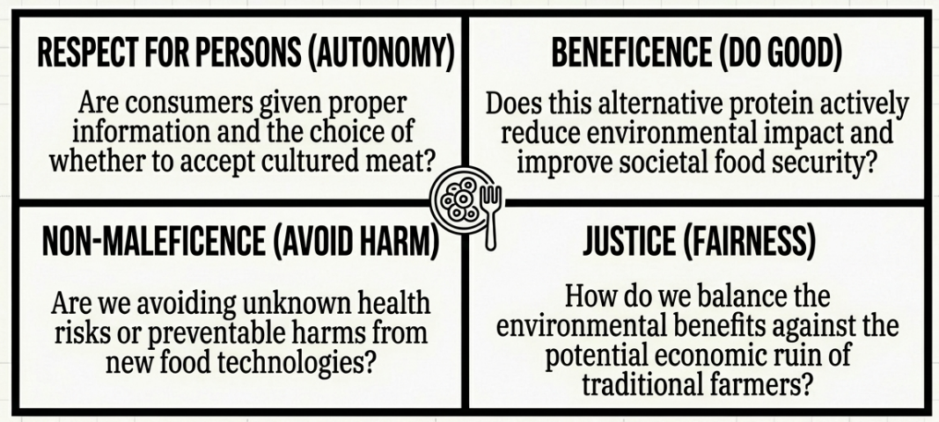
Applying the principles to the cultured meat case

Slide 9
Moral Responsibility
Moral responsibility refers to:
Being accountable for actions and their consequences
Being answerable for outcomes that affect others
In science and technology:
Actions can have wide societal impacts
Responsibility is not limited to one individual

Slide 10
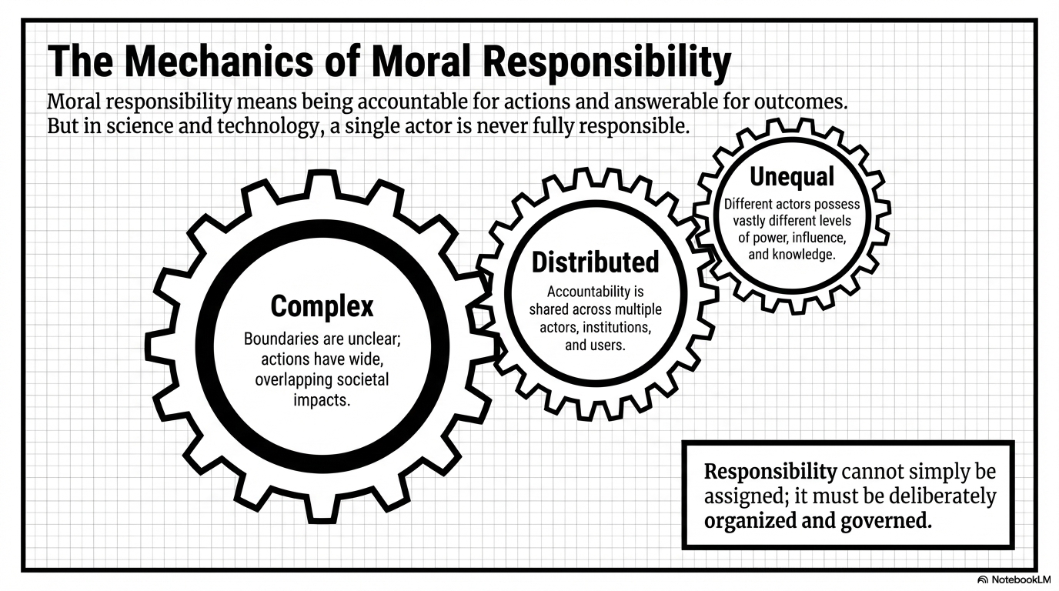

Slide 11
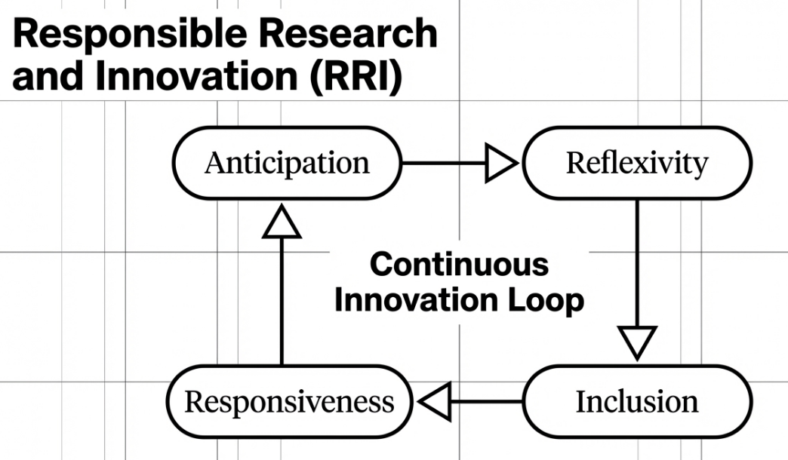

Slide 12
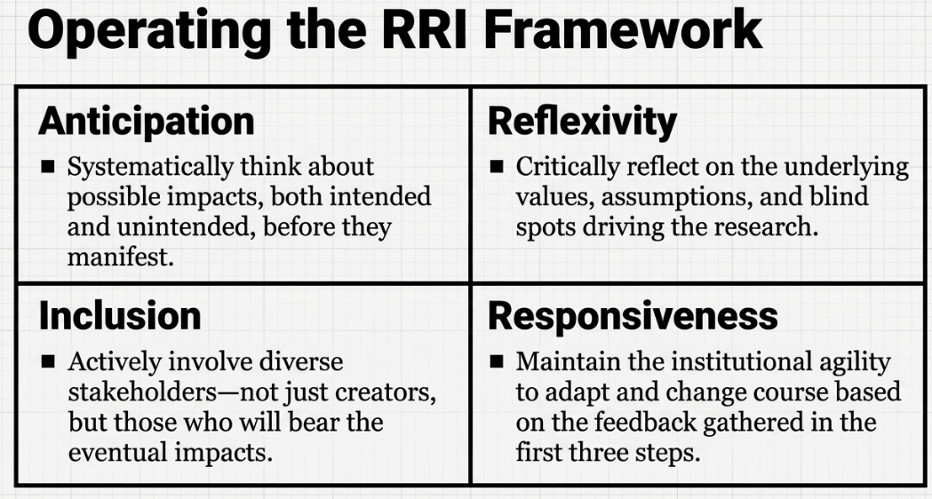

Slide 13
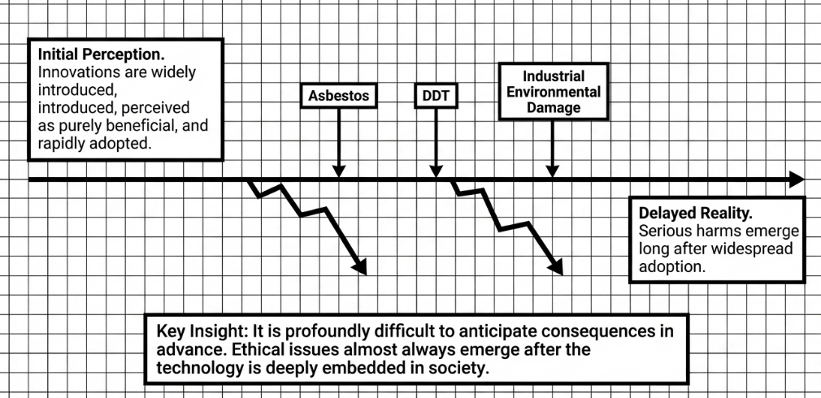
Why RRI?

Slide 14
